Slide 1
EEE 316: power electronics project
Dc Variable Power supply
group:4
1706131 Ashrafia Khanom
1706138 Shakhawat Iqbal Ovi
1706140 Tanveer Aziz Durbar
1706147 Samiha Tahsin

Slide 2
objectives
Regulated DC Power Supplies.
Provide accurate DC voltage, derived from AC mains.
Provide constant voltage irrespective of load variations.
Ensuring short circuit protection.
Cheaper in nature and lightweight circuit.

Slide 3
INTRODUCTION
A variable dc power supply is one which includes some means for the user to easily adjust the output voltage and sometimes the current. Adjustment is most often accomplished with a potentiometer, but may also be done with an analog control voltage, a digital input, an autotransformer, etc.

Slide 4
Required components
Step Down Transformer
TL – 431
Transistor
Diodes
Capacitors
Resistors
Potentiometer
Wires
Bread-Board

Slide 5
WORKING
The main working principle of this project is full wave rectification which is done by full wave bridge rectifier. This rectifies the output of the step-down transformer of 220 to 12 volts rating.
Here we are using a shunt voltage regulator which give constant voltage.
We have used the pair of voltage divider resistors to increase the output of the regulator in which the resistance is variable. So when we increase or decrease the value of that resistor the output voltage of the regulator will also change and we get a range of 2 to 12 V.

Slide 6
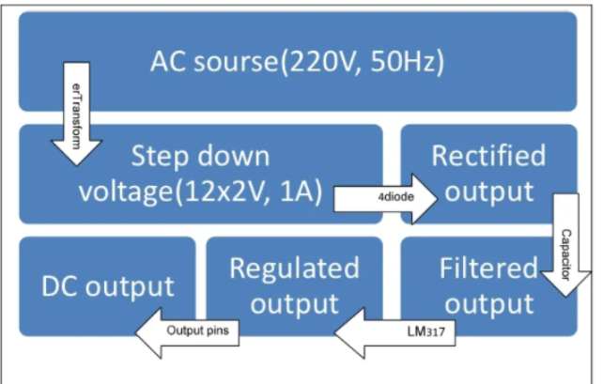
BLOCK DIAGRAM

Slide 7
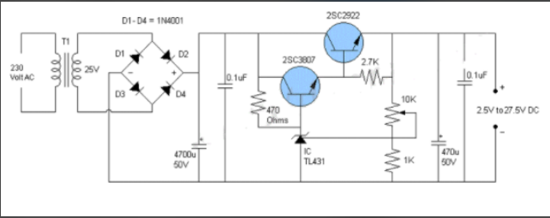
Circuit Diagram

Slide 8
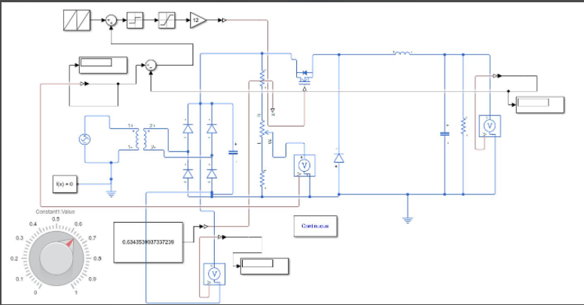
Simulink Circuit Diagram

Slide 9
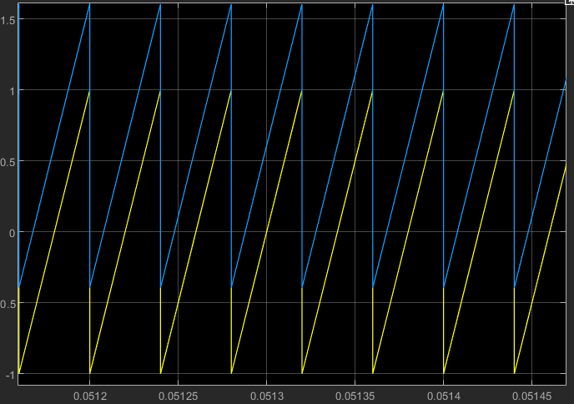
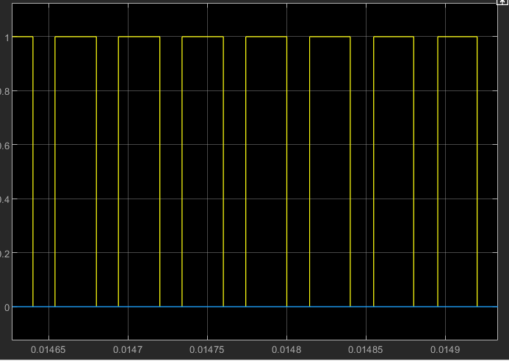
BUCK CONVERTER PRINCIPLE
Buck converter principle:
Vo = D*Vs
D=Duty Cycle
Yellow = 50% duty cycle
Blue = shifted sawtooth for >=50% duty cycle

Slide 10
PROBLEM FACED AND OVERCOMING AND LIMITATIION
The circuit cannot make the output 0 voltage.
The circuit was very unstable initially and cannot give a fixed value of voltage.
After adding multiple capacitor the value is quite stable. Capacitor reduce the ripple voltage and stable the unstability.

Slide 11
APPLICATION
We can use it in laboratory as a voltage source.
Overcome the noise effect of the circuit by changing load resistance and voltage.
To make a circuit error free and flawless.

